Slide 1
Components of blood
Blood –collection of fluid and cells
Fluid component- plasma
Cells- red cells , white cells and platelets

Slide 2
Components of blood
Separation of components
Collect blood sample in to a tube and centrifuge it .
Cells go to bottom
Liquid component remains on top of the cell column

Slide 3
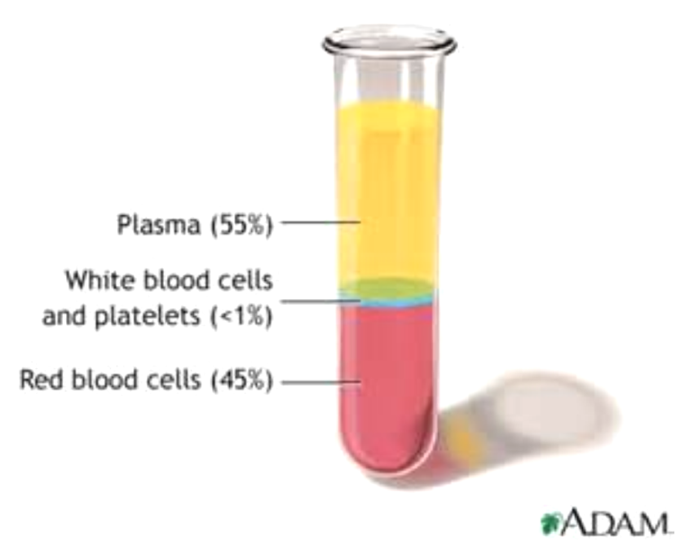
Components of blood

Slide 4
Components of blood
Red cells- 45%
Plasma – 55%
White cells –less than 1%
Plasma contains clotting factors
Removal of fibrin and clotting factors from plasma results serum

Slide 5
Packed cell volume _ haematocrit (PCV-Hct)
  Height of red cell column as a percentage of total column
  Done by using Winthrob tube and anticogulted blood
Rate depends on
  Number o red cells in plasma
  Negative charge on red cells
  Presence of ibrin and rouleaux formation

Slide 6
ESR
Erythrocyte sedimentaion rate
is the rate at which red blood cells sediment in a period of one hour
Done using anticoagulated blood and wetergen tube

Slide 7
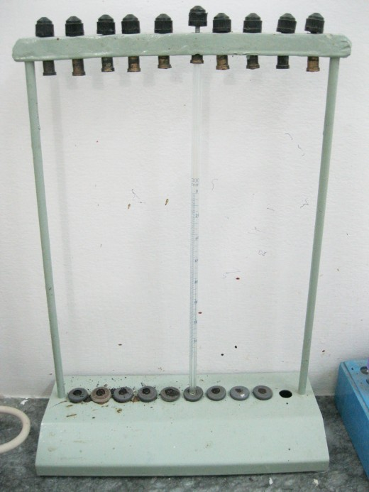
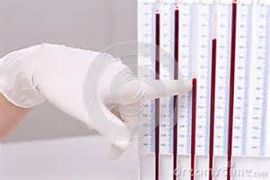

Slide 8
Anaemia
Dr. K. Medagoda
Department of Physiology

Slide 9
Erythropoiesis
Red cell production happens in the bone marrow
Red cell precursors pass through several stages
Progressively the precursors mature in to red cells
  Contain less RNA
  More haemoglobin

Slide 10
Erythropoiesis
Erythropoiesis is controlled by hormone erythropoietin
  Secreted mainly by the kidney-90%
  liver -10%
Erythropoietin secretion is mainly regulated by the tissue oxygen tension
Hypoxia for any reason stimulates erythropoietin secretion

Slide 11
Erythropoiesis
Factors needed for normal erythropoiesis
  Iron
  Vitamin B 12
  Folate
  Vitamins- B6 , Thiamine, Riboflavin, Vit C and E
  Micronutrients – Cobalt
  Androgens
  Thyroxin

Slide 12
Red Cell Indices
Mean corpuscular Volume- MCV (fL)
  The most useful one to classify anaemia
  = HCT X 10/ Red blood cell count(10⁶/microL)
Mean corpuscular haemoglobin -MCH – (pg)
  =Hb X 10/ Red blood cell count(10⁶/microL)
Mean corpuscular haemoglobin concentration -MCHC (g/dL)
  =Hb X 100/ Hct

Slide 13
Red Cell Indices
Normal Values
Hb | Male- 14.0-17.7g/dl Female- 12.0-16.0g/dl
MCV | 80-96fl
MCH | 27-33pg
MCHC | 32-35 g/dl

Slide 14
Extramedullary erythropoiesis
  Erythropoiesis happening in other site except bone marrow
  Usually the liver and the spleen
  Results enlargement of the liver and the spleen
  I.E hepatomegaly and splenomegaly

Slide 15
Anaemia
Decrease in the level of haemoglobin in the blood below the reference level for the age and the sex of the individual.
Common features
  Malaise, lethargy, tiredness, exertional dyspnoea

Slide 16
Classification of anaemia
According to MCV
  hypochromic microcytic
  normochromic normocytic
  macrocytic
According to basic pathology
  Decreased production - marrow failure
  Increased loss- chronic bleeding
  Increased destruction - haemolysis

Slide 17
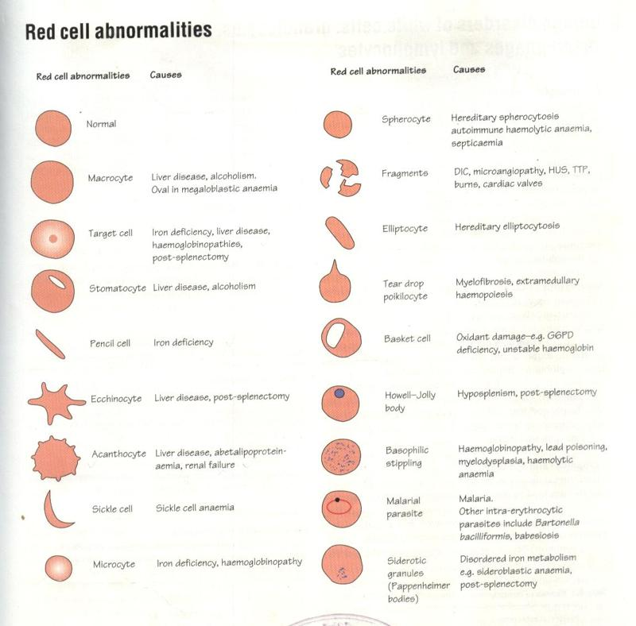
 | Normal
 | Microcyte | Iron deficiency, Haemoglobinopathies
 | Macrocyte | Megaloblastic anaemia, Liver disease, Hypothyroidism
 | Target cell | Iron deficiency, Haemoglobinopathies
 | Spherocyte | Hereditary Spherocytosis
 | Sickle cell | Sickle cell disease
 | Pencil cell | Iron deficiency, Haemoglobinopathies
 | Ecchinocyte | Liver disease
 | Acanthocyte | Renal failure, liver disease

Slide 18
 | Stomatocyte | Liver disease, Alcoholism
 | Eliptocyte | Hereditary eliptocytosis
 | Fragmented cell | Disseminated intravascular coagulation
 | Tear drop cell | Extramedullary haemopoiesis, Myelofibrosis

Slide 19
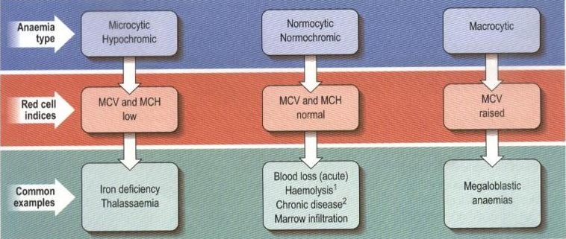
Classification of anaemia

Slide 20
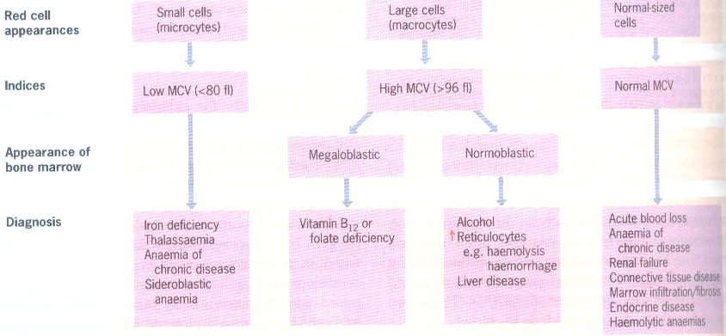

Slide 21
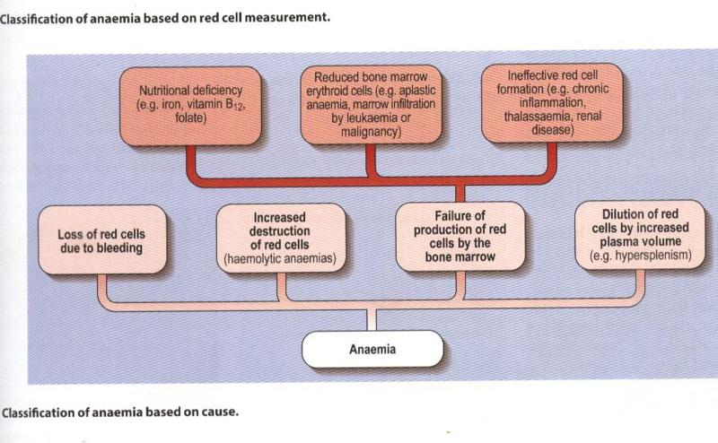
Classification of anaemia

Slide 22
Hypochromic microcytic anaemia
Key features in red cell indices
  Low MCV
  Low MCH
Causes
  Iron deficiency
  Haemoglobinopathies
    Thalassaemia

Slide 23
Hypochromic microcytic anaemia
  Iron deficiency anaemia
  Commonest cause
  Result of
    Limited ability of the body to absorb iron
    Frequent increased loss
Iron is needed for Hb synthesis

Slide 24
Iron deficiency anaemia
Causes
  Chronic blood loss
  Increased demand
  Poor dietary intake
  Decreased absorption

Slide 25
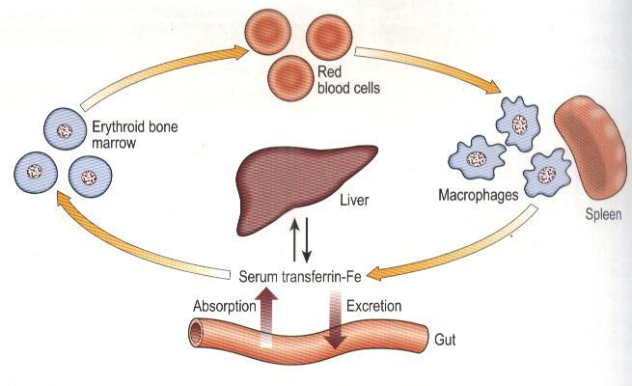
Iron deficiency anaemia

Slide 26
Iron deficiency anaemia
  Chronic blood loss
    Mostly form the GI tract
      Hook worm infestation
      Carcinoma ( cancer large bowel)
    Form abnormal menstruation in females
  Increased demand
    Growth and pregnancy
  Poor dietary intake
  Decreased absorption
    Post gastrectomy

Slide 27
Iron deficiency anaemia
Features
  Feature s of anaemia
    Malaise, lethargy, tiredness, exertional dyspnoea
  Specific to iron deficiency
    Spoon shaped nails- koilonychia
    Brittle nails
    Angular stomatitis
    Glossitis – atrophy of tongue papillae

Slide 28
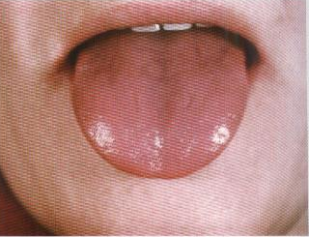
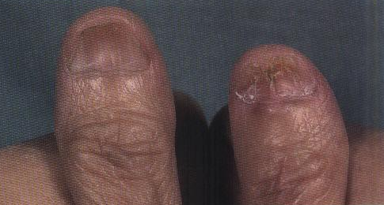
Iron deficiency anaemia
Glossitis
Koilonychia, brittle nails

Slide 29
Iron deficiency anaemia
Investigations
Hb -low – less than reference value
MCV – less than 80fl
MCH- less than 27
Blood film
Hypochromic microcytic
Bone marrow-
  Erythorid hyperplasis
  Negative for Perl’s reaction- No Prussian-blue granules
Iron studies

Slide 30
Iron deficiency anaemia
Iron studies
Serum iron – low
Iron binding capacity – TIBC- high
Serum ferritin- low
  Reflects the stored iron

Slide 31
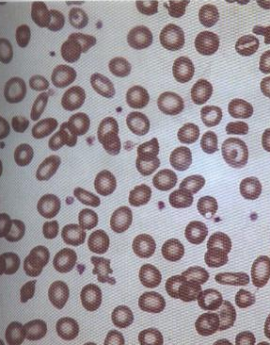
Iron deficiency anaemia

Slide 32
Normochromic normocytic anaemia
Seen in chronic diseases
  Chronic infections, malignancies
  Major organ failures
  Endocrine disodres
    Hypoadrenalism, hypopituitarism
Key features in red cell indices
  Low Hb
  Normal MCV, MCH

Slide 33
Macrocytic anaemia
Two forms
Key features
  Low Hb
  High MCV >100
1. Megaloblastic
2. non Megaloblastic

Slide 34
Megaloblastic anaemia
Characterised by presence of megaloblasts in the bone marrow
Megaloblasts
  Erythroblasts with delayed maturation
  Due to defective DNA synthesis
  Large and have immature nuclei

Slide 35
Megaloblastic anaemia
Occurs in
  Vitamin B 12 deficiency
  Folate deficiency
Investigations
  Hb- Low
  MCV – high >100fl
  Blood film- Macrocytes and hypersegmented neutrophis
  Bone marrow- megaloblasts

Slide 36
Megaloblastic anaemia
Biochemical basis
  Read biochemistry
  Block in DNA synthesis
  Due to lack of methyl group
  Methyl group supplied by tetra hydrofolate
  Vitamin B12 deficiency also reduces the formation of tetra hydrofolate

Slide 37
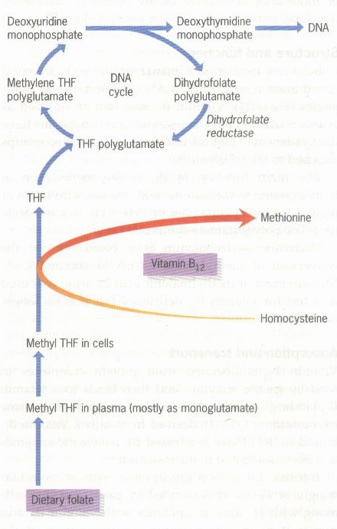

Slide 38
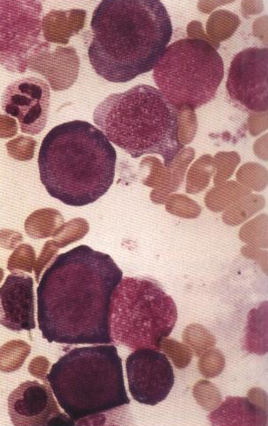

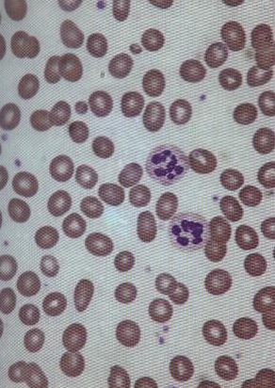
Megaloblastic anaemia
Macrocytes with hyper-segmented neutrophils
Megaloblasts in the bone marrow

Slide 39
Megaloblastic anaemia
Vitamin B12 deficiency
Vitamin B12
  Synthesised by microbes
  Humans depend on animal sources
  Average adult store 2-3mg – mainly in liver
  Daily loss is small
  Sufficient for about 2 years –before deficiency sets in

Slide 40
Vitamin B12
Structure
  a cobalamin with a central cobalt atom
Function
  Co enzyme for methylation of homocystine to methionine

Slide 41
Vitamin B 12
Absorption
  Liberated from the protein complexes in food by gastric enzymes and HCl
  Then binds to two B12 binding proteins
    Intrinsic factor and R binder
  Vit B12 bound to R factor is released by pancreatic enzymes and get bounds to intrinsic factor
  IF carries Vit B12 to terminal ileum
  Terminal ileum mucosa has specific receptors for B12
  Vit B12 enters in to the cells and IF remains in the lumen

Slide 42
Vitamin B12
Transport
Binding proteins
  transcobalamin I,II ,III
Transcobalamin I
  Main binding protein
  Unable to deliver B12 to marrow
Transcobalamin II
  Transport Vit B12 from the enterocytes to bone marrow
Transcobalamin III
  Binding protein unable to deliver B12 to marrow

Slide 43
Megaloblastic anaemia
Vit B12 deficiency
Causes
  Vegans – low intake
  Impaired absorption
    Pernicious anaemia
    Gastrectomy –lack of intrinsic factor
    Ileal disease or resection
    Bacterial overgrowth
Pernicious anaemia
  Atrophy of gastric mucosa
  Lack of intrinsic factor

Slide 44
Megaloblastic anaemia
Vit B 12 deficiency -Features
Anaemia
Involvement of the central nervous system
  Peripheral nerve damage
  Posterior column damage
  Pyramidal tract damage
  Dementia

Slide 45
Megaloblastic anaemia
Haematological findings
  Low Hb
  High MCV
  Macrocytes in blood film
  Megaloblasts in bone marrow
  Low serum B 12 levles
  Abnormal Schilling test

Slide 46
Megaloblastic anaemia
Folate deficiency
Folic acid
  Tetrahydro folate acts as coenzyme
  Transfers of single carbon units in DNA synthesis
  Found in green vegetables
  Cooking destroys folate

Slide 47
Megaloblastic anaemia
Folate deficiency
  Poor dietary intake
  Excess alcohol
  Increased utilization
    Pregnancy, lactation
  Haematological diseases
    Haemolysis, malignancies with high cell turn over
  Anti Folate drugs

Slide 48
Megaloblastic anaemia
Haematological findings
  Low Hb
  High MCV
  Macrocytes in blood film
  Megaloblasts in bone marrow
  Low serum and red cell folate

Slide 49
Megaloblastic anaemia
Treatment
Vit B12 or folate therapy
Folic acid alone must not be used to treat megaloblastic anaemia
  Coexisting Vit B12 results worsening of the neurological disease

Slide 50
Macrocytic anaemia with out megaloblasts
Raised MCV
No megaloblasts in the marrow
Causes
  Alcohol excess
  Liver disease
  Hypothyroidism

Slide 51
Haemolytic anaemia
Increased destruction of the red cells
Sites of haemolysis
  Extra vascular
    In the reticuloendothelial system
    Mostly in the spleen

Slide 52
Haemolytic anaemia
Evidence for haemolysis
  Elevated serum unconjugated bilirubin
    Liver has about 7 more times capacity than normal for conjugation
    Therefore mild elevation of unconjugated bilirubin
    Mild jaundice
  Increased urinary urobilinogen/stercobilinogen
    Dark coloured urine on standing
    Dark coloured stools

Slide 53
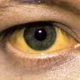

Slide 54
Haemolytic anaemia
Inherited haemolytic anaemias
Causes
  Red cell membrane defects
    Hereditary Spherocytosis
  Haemoglobinopathies
    Quantitative abnormalities
    Qualitative abnormalities
  Metabolic disorders of the red cells

Slide 55
Haemoglobinopathies
  Quantitative abnormalities
    Normal structure
    Abnormal levels of either alpha or beta chains
      Alpha or beta Thalassaemia
  Qualitative abnormalities
    Abnormal structure
      Sickle cell disease

Slide 56
  Metabolic disorders of the red cells
  G 6PD deficiency
  Pyruvate kinase deficiency

Slide 57
Haemolytic anaemia
Red cell membrane defect
Hereditary Spherocytes
  Autosomal dominant disease
  Deficiency of spectrin in the red cell membrane
  Surface to volume ratio decreases
  Cells become spherocytes
  Spherocytes are rigid and less deformable
  Unable to pass through the spleen

Slide 58
Hereditary Spherocytes
Features
  Anaemia
  Mild unconjugated janundice
  Splenomegaly
  Foot ulcers

Slide 59
Hereditary Spherocytes
Investigations
  Low Hb
  Spherocytes in the blood film
  Increased osmotic fragility

Slide 60
Osmotic fragility test
  When red cells placed in increasing hypotinic solutions
  Red cells take water , swell up
  Eventually lyse releasing Hb to solution
  Spherocytes can not tolerate hypotonicity as normal red cells
  Therefore increased osmotic fragility
  Read practical manual

Slide 61
Haemoglobinopathies
Quantitative Haemoglobinopathies
Hb molecule structure is normal
There is reduction of alpha or beta chains
Reduction of
  Alpha chains – alpha Thalassaemia
  Beta chains – beta Thalassaemia

Slide 62
Thalassaemia
 | Type of haemoglobin | Structure
Normal | HbA₁ 92% | α₂β₂
 | HbA₂ 2% | α₂δ₂
 | HbF <1% | α₂γ₂
β thalassaemia | Increased HbA_{2,} HbF
Alpha thalassaemia Major | Hb Barts | γ₄
Alpha thalassaemia | HbH | β₄

Slide 63
beta Thalassaemia
Autosomal recessive inheritance
Normally there is 1:1 production of alpha and beta chains
In beta thalassaemia beta chain production is reduced
Excess of alpha and gamma chains precipitates in erythroblasts
Results haemolysis
Ineffective erythropoiesis

Slide 64
beta Thalassaemia
Excess alpha chains combine with whatever
  Beta, gamma and delta chains available
Results
  Increased HbF , HbA₂,
  Combination of 4 gamma chains- Hb Barts
  Hb Barts precipitates in the erythroblasts
  Leading to haemolysis and ineffective erythropoiesis

Slide 65
beta Thalassaemia
Syndromes
  Thalassaemia major
  Thalassaemia trait
Thalassaemia major
  Found in Homozygous individuals
  Severe form of disease
  Present during first year of life
  Needs recurrent blood transfusions
  Leads to iron over load

Slide 66
beta Thalassaemia
Thalassaemia trait (minor)
  Found in heterozygous individuals
  Mild form of disease
  Usually go unnoticed
  Iron studies are normal

Slide 67
beta Thalassaemia
Investigations
  Low Hb
  Low MCV – disproportionate to degree of anaemia
  Low MCH
  Hypochromic microcytic cells
  Lots of target cells
  Increased serum iron , ferritin, low TIBC in major thalassaemia
  Hb electrophoresis- low HbA1 , high HbF

Slide 68
Alpha Thalassaemia
Reduction in alpha chain production
Excess of beta and gamma chains
Severe form
  No alpha chains
  Accumulation of gamma chains- γ₄ – Hb Barts

Slide 69
Haemoglobinopathies
Qualitative Haemoglobinopathies
  Normal amounts
  Abnormal structure
    HbS –Sickle cell disease
    HbC, HbD, HbE diseases

Slide 70
Sickle cell disease
Single base mutation
Substitution of valine for glutamine
Deoxygenated HbS
  Insoluble and polymerize
  Flexibility of the cells reduced
  Cells become rigid and assumes sickle shape
Sickling is produced by
  Hypoxia, infections, acidosis and dehydration

Slide 71
Sickle cell disease
Investigations
  Low Hb
  Positive sickling test
  Increased HbS in Hb electrophoresis

Slide 72
Metabolic red cell disorders
G6PD deficiency
  Unable to tolerate oxidant stress
  Results rapid intravascular haemolysis
    Anaemia
    Jaundice
    Haemoglobinuruia

Slide 73
G6PD deficiency
Causes
  drug induced – eg. cholroquine
  Ingestion of fava beans

